Slide 1




Life Expectancy Analysis
Jaspreet Singh
Mohini Yadav
Phuong Han
Nithiya

Slide 2
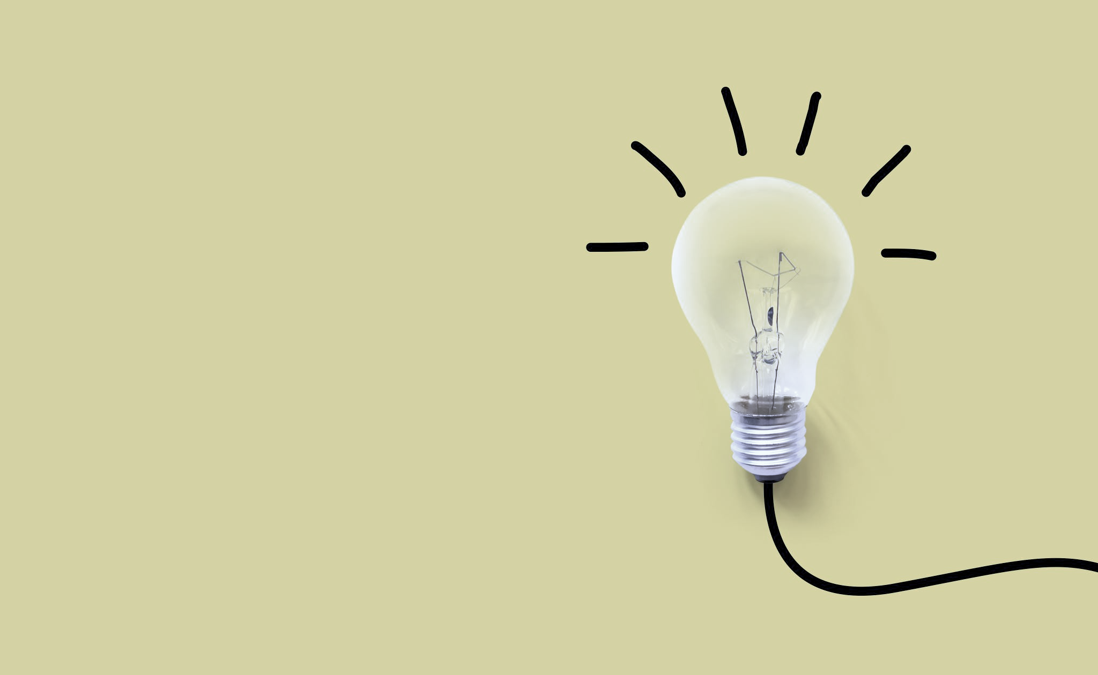
When we were looking for project ideas and dataset, we went through Kaggle for ideas. The life expectancy page on Kaggle grabbed our attention and looking through the dataset – we became inquisitive of the life expectancy rate across the world – that includes both developing and developed countries.
Researching further and with inputs from Vicki and Adnan, we also came across a Ted Talk video by Hans Rosling in which he points out the preconceived ideas that are in existence about life expectancy – comparing the western world and third world countries.

Slide 3

Resources links for data and project
https://www.kaggle.com/kumarajarshi/life-expectancy-who
https://www.kaggle.com/andradaolteanu/country-mapping-iso-continent-region
https://www.ted.com/playlists/474/the_best_hans_rosling_talks_yo
https://plotly.com/javascript/gapminder-example/
https://plotly.com/javascript/choropleth-maps/
https://plotly.com/javascript/box-plots/
Our class activities for flask app, jsonify and drop-down menu plots and Heroku app.
Tutors, TA’s, BCS Assistant, friends in the group.
And finally, of course - stack overflow again and again.

Slide 4
ETL process
Extraction:
Data extraction from both life_expectancy.csv and continents.csv file.
The column names in the csv files has spaces and sorts of issues, which needed to be cleaned up.
Transform:
Using python code, the data from both the csvs were cleaned, and merged based on the country columns, so the retrieved data can be matched as per continents and countries.
Load:
The database used to load data into is SQLite. We had issues loading and viewing the data using SQLite, as we were trying to load data into database using our pandas code rather than creating schema and loading data.
After a lot of research and help from all the available resources, we were able to successfully load and view the data into SQLite database.

Slide 5
Challenges
Loading and reading data into SQLite database, instead of using PostGres SQL database. As we used pandas to create the database, and not schema.sql – lot of research and resources were used to make SQLite work and load the data.
Creating Flask app to connect to SQLite database and retrieve data.

Slide 6
Our Project – GitHub page
https://github.com/nithiyasuresh/LifeExpectancy_Project
Hosted on - Life Expectancy

Slide 7
Our Analysis
All of you probably have heard the lines about how “40 is the new 30” or “30 is the new 20.” What is this based on? We tried to solve the problem using life expectancy data with some visualisations.
The following three visualizations examine life expectancies to discuss this tendency of humans to generalize and how the right visualizations can help us better understand the world we live in.
Global choropleth by country (while many counties in Europe have higher life expectancies (darker in color) not all countries in Europe have longer life expectancies than some African countries.
This tendency to group countries together comes from the "flaw of averages." While a single average can be used to categorize an entire region, often the real information is missed (this can happen if one only looks at the median values for each region in the box plot vs. the true spread of life expectancy that can only be seen at the country level.
This spread can be seen for each year using the bubble chart where regions can be turned on and off so can see many "western countries" have a lower life expectancy than the countries we might categorize as "third world" like those countries in Africa.
People live longer in countries with a higher GDP per capita. Or put differently; in countries with longer lives, GDP per capita is higher. However, The connection between health and wealth doesn’t tell us which comes first. But one thing is clear: there are not two groups of countries, despite what many people think. Dividing the countries into two groups, developing vs. developed, is extremely misleading. Simply because While this might be true on average, there are several African countries that have longer life expectancies than some European countries.

Slide 8
Conclusion
People live longer in countries with a higher GDP per capita. Or put differently; in countries with longer lives, GDP per capita is higher. However, The connection between health and wealth doesn’t tell us which comes first. But one thing is clear: there are not two groups of countries, despite what many people think.
Dividing the countries into two groups, developing vs. developed, is extremely misleading. Simply because while this might be true on average, there are several African countries that have longer life expectancies than some European countries.
In early 2000, income per person was low and life expectancy was very short in all countries.
Income per capita is better everywhere today, even in the poorest countries. So, over the last decades this global inequality decreased. Many countries that not long ago were suffering from poor economic conditions are catching up rapidly.
Income is much higher in most, but not all, countries today. Most people today live in “middle income” countries.
It has been observed that in the past 15 years , there has been a huge improvement in the income levels per capita resulting in improvement of human mortality rates especially in the developing nations in comparison to the past 30 years.

